Slide 1
Antimicrobial Stewardship Program Annual Update
ASP PROGRAM LEADERS

Slide 2
What is antimicrobial stewardship?
Antimicrobial stewardship is the effort to measure and improve how antibiotics are prescribed by clinicians and used by patients.
US Centers for Disease Control and Prevention. https://www.cdc.gov/antibiotic-use/core-elements/index.html#print
Notes:
New Program Script:
The CDC Core Elements document defines antimicrobial stewardship as the effort to measure and improve how antibiotics are prescribed by clinicians and used by patients. Our hospital’s antimicrobial stewardship program just got off the ground in [month, year], but has several goals to improve antibiotic use over the coming year that will be reviewed later in this presentation. In today’s presentation, I will discuss how antimicrobial use at our facility compares to other hospitals within our healthcare system and state.
Established Program Script:
The CDC Core Elements document defines antimicrobial stewardship as the effort to measure and improve how antibiotics are prescribed by clinicians and used by patients. At [INSERT HOSPITAL NAME], our antimicrobial stewardship program has been working to improve antibiotic use since [insert month and year of stewardship program start]. Some of our wins over the years include: [list major program accomplishments with focus on % reductions in antibiotic use categories, state and local program recognition, positive results from regulatory surveys, and cost-saving initiatives, if applicable]. Our goals for the coming year will be reviewed later in this presentation. In today’s presentation, I will discuss how antimicrobial use at our facility compares to other hospitals within our healthcare system and state.

Slide 3
How do we monitor Antimicrobial Use?
Hospitals submit antimicrobial use data to National Healthcare Safety Network (NHSN) Antimicrobial Use (AU) Option for adult and pediatric patients.
Standardized Antimicrobial Administration Ratio (or SAAR) is a metric comparing observed antimicrobial use to expected antimicrobial use.
SAAR <1.0 indicates antimicrobial use was less than expected
SAAR =1.0 indicates that antimicrobial use was equivalent to predicted use
SAAR >1.0 indicated antimicrobial use was greater than predicted.
SAAR metrics are available for adult and pediatric patients over a range of categories that can be used to compare antimicrobial use among hospitals and hospital units.
Notes:
Our hospital reports to the Antimicrobial Use (or AU) option of the CDC’s National Healthcare Safety Network (or NHSN) for adult and pediatric patients. By reporting to this surveillance resource, we are able to retrieve actionable data on how our hospital’s antimicrobial use compares to other hospitals.
The CDC has created a metric called the Standardized Antimicrobial Administration Ratio (or SAAR), which is a ratio to comparing observed antimicrobial use to expected antimicrobial use. A SAAR <1.0 indicates antimicrobial use was less than expected, a SAAR =1.0 indicates that antimicrobial use was equivalent to predicted use and a SAAR >1.0 indicated antimicrobial use was greater than predicted. SAAR metrics are available to compare adult and pediatric antimicrobial use across facilities. There are also several groups of agents that have individual SAARs, such as antibacterial agents used predominantly for resistant Gram-positive infection and broad spectrum antibacterials used for hospital-onset infections.

Slide 4
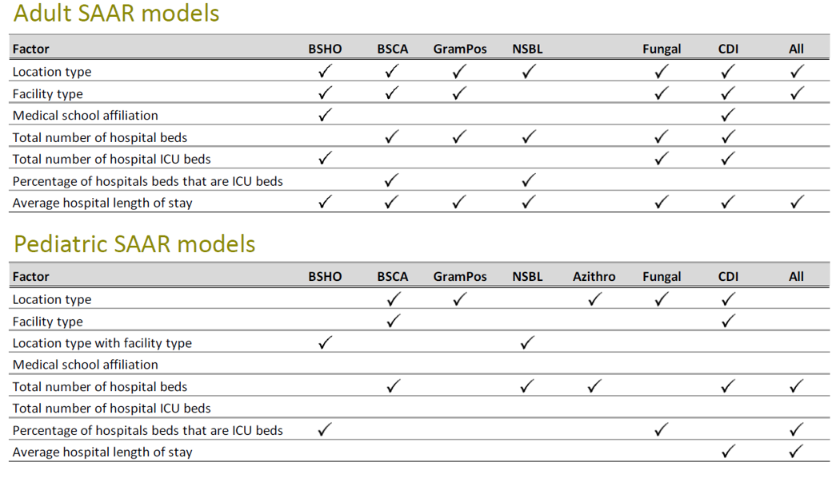
SAAR Risk Adjustments
BSHO: Broad Spectrum Hospital Onset; BSCA: Broad Spectrum Community Acquired; GramPos: Agents to treat Gram-positive infections; NSBL: Narrow spectrum beta-lactam agents; CDI: Antibacterial agents posing the highest risk of CDI
Notes:
SAAR data are risk adjusted based on several factor for both adult and pediatric models as shown in the table on this slide. There is still minimal adjustment for patient case-mix.

Slide 5
How does our hospital compare to other hospitals within our healthcare system?
50th Percentile SAAR for [insert state name]
Notes:
This graph shows how our hospital compares to other hospitals within our healthcare system and the state in overall antimicrobial use. On the x-axis, each bar represents a different hospital in our healthy system. [Insert your hospital name] is represented in the darker blue. The SAAR value is on the y-axis and you will note that our hospital has a SAAR [include SAAR number and interpretation]. The horizontal line represents the 50th percentile SAAR for our state, which is [insert state SAAR value]. Based on these data, you will see that our overall antimicrobial use is [above, below, at] the expected national SAAR value and [above, below, equal to] the SAAR for our state.
Please consider the following spell out SAAR in y-axis or make footnote; label the black line, provide a conclusion bullet (or add another slide for next steps).
Can u make the Test facility name shorter so doesn’t run into the x-axis. Personally, I like when the graphic is larger (and remove the logo on bottom right) so can more clearly see the data.

Slide 6
Moving Forward: Antimicrobial Stewardship Program Goals
Our antimicrobial stewardship program has developed the following goals to [reduce, optimize and maintain] antimicrobial use in the coming months:
1. [List goal]
2. [List goal]
3. [List goal]
We will continue to use the SAAR to measure the progress on these goals and share updates with the administrative team on how our hospital’s use compares to other hospitals within our network and the state.
Notes:
Now that we have reviewed our hospital’s SAAR data, we wanted to discuss the goals for the coming year that we have made to address areas of higher than expected use within our facility [Note: If your facility does not have elevated SAARs, you can open with a statement like this: While our SAARs remain lowed than expected, there are still many opportunities to optimize antimicrobial use that have been identified by the antimicrobial stewardship team.] [At this point in the talk, discuss stewardship goals and progress.]
We will continue to share SAAR data and our goals with this team in the future and encourage you to reach out to us if any questions arise related to antimicrobial use at our facility. Now, I will open the floor to questions.

Slide 7
EXTRA SLIDES

Slide 8
SAAR Adult Groups
Adult Groups | Agents
Antibacterial agents predominantly used for resistant Gram-positive infections (e.g. MRSA) | Ceftaroline, Dalbavancin, Daptomycin Linezolid, Oritavancin, Quinupristin with Dalfopristin, Tedizolid, Telavancin, Vancomycin (IV only)
Broad spectrum antibacterial agents predominantly used for community-acquired infections | Cefaclor, Cefdinir, Cefixime, Cefotaxime, Cefpodoxime, Cefprozil, Ceftriaxone, Cefuroxime, Ciprofloxacin Ertapenem, Gemifloxacin, Levofloxacin, Moxifloxacin
Broad spectrum antibacterial agents predominantly used for hospital-onset infections | Amikacin (IV only), Aztreonam (IV only) Cefepime, Ceftazidime, Doripenem Gentamicin (IV only), Imipenem with Cilastatin, Meropenem, Piperacillin with Tazobactam, Tobramycin (IV only)
Narrow spectrum beta lactam agents | Amoxicillin, Amoxicillin/clavulanate, Ampicillin, Ampicillin/sulbactam, Cefadroxil, Cefazolin, Cefotetan, Cefoxitin, Cephalexin, Dicloxacillin, Nafcillin/ Oxacillin, Penicillin G and V
NSHN AUR Module, January 2019
https://www.cdc.gov/nhsn/pdfs/pscmanual/11pscaurcurrent.pdf

Slide 9
SAAR Adult & Pediatric Groups
Adult & Pediatric Groups | Agents
Antibacterial Agents posing the highest risk for CDI | Cefdinir, Cefepime, Cefixime, Cefotaxime, Cefpodoxime, Ceftazidime, Ceftriaxone, Clindamycin, Ciprofloxacin, Gemifloxacin, Levofloxacin, Moxifloxacin
Antifungal Agents predominantly used for invasive candidiasis | Anidulafungin, Caspofungin, Micafungin, Fluconazole

Slide 10
SAAR Pediatric Groups
Adult & Pediatric Groups | Agents
Antibacterial agents predominantly used for resistant Gram-positive infections (e.g. MRSA) | Ceftaroline, Clindamycin, Dalbavancin, Daptomycin Linezolid, Oritavancin, Quinupristin with Dalfopristin, Tedizolid, Telavancin, Vancomycin (IV only)
Broad spectrum antibacterial agents predominantly used for community-acquired infections | Amoxicillin/clavulanate, Ampicillin/sulbactam, Cefaclor, Cefdinir, Cefixime, Cefotaxime, Cefpodoxime, Cefprozil, Ceftriaxone, Cefuroxime
Azithromycin | Azithromycin
Broad spectrum antibacterial agents predominantly used for hospital-onset infections | Amikacin (IV only), Aztreonam (IV only) Cefepime, Ceftazidime, Doripenem Gentamicin (IV only), Imipenem with Cilastatin, Meropenem, Piperacillin with Tazobactam, Tobramycin (IV only), Ertapenem, Ciprofloxacin, Gemifloxacin, Levofloxacin, Moxifloxacin
Narrow spectrum beta lactam agents | Amoxicillin, Ampicillin, Cefadroxil, Cefazolin, Cefotetan, Cefoxitin, Cephalexin, Dicloxacillin, Nafcillin/ Oxacillin, Penicillin G and V
NSHN AUR Module, January 2019
https://www.cdc.gov/nhsn/pdfs/pscmanual/11pscaurcurrent.pdf

Slide 11
Groups with SAAR ≤ 1.0 for Adults
Group Name | [Hospital Name] SAAR | [State Initials] SAAR | Rank of __ Hospitals in Network
Groups with SAAR ≤ 1.0 for Pediatrics
Group Name | [Hospital Name] SAAR | [State Initials] SAAR | Rank of __ Hospitals in Network
Notes:
The antimicrobial use groups listed on this slide for adult and pediatric values were areas where our antimicrobial use was at or below the expected target. We will continue to monitor antimicrobial use in these areas using SAAR data.
Discussion: This is an example slide that reviews how a site could present SAAR data briefly for the categories to administration. It would allow your team to quickly highlight areas of below expected use and target areas for future initiatives. A rank of 1 would indicate the lowest SAAR in the group.

Slide 12
Groups with SAAR > 1.0 for Adults
Group Name | [Hospital Name] SAAR | [State Initials] SAAR | Rank of __ Hospitals in Network
Groups with SAAR > 1.0 for Pediatrics
Group Name | [Hospital Name] SAAR | [State Initials] SAAR | Rank of __ Hospitals in Network
Notes:
The antimicrobial use groups listed on this slide for adult and pediatric values were areas where our antimicrobial use was at or below the expected target. Our stewardship team used these values to set goals to improve antimicrobial use in [these, some of these] groups, which will be reviewed later in this presentation.
Discussion: This is an example slide that reviews how a site could present SAAR data briefly for the categories to administration. It would allow your team to quickly highlight areas of below expected use and target areas for future initiatives. A rank of 1 would indicate the lowest SAAR in the group. Pediatric tables may be removed if they are not relevant to your practice site.

